Slide 1
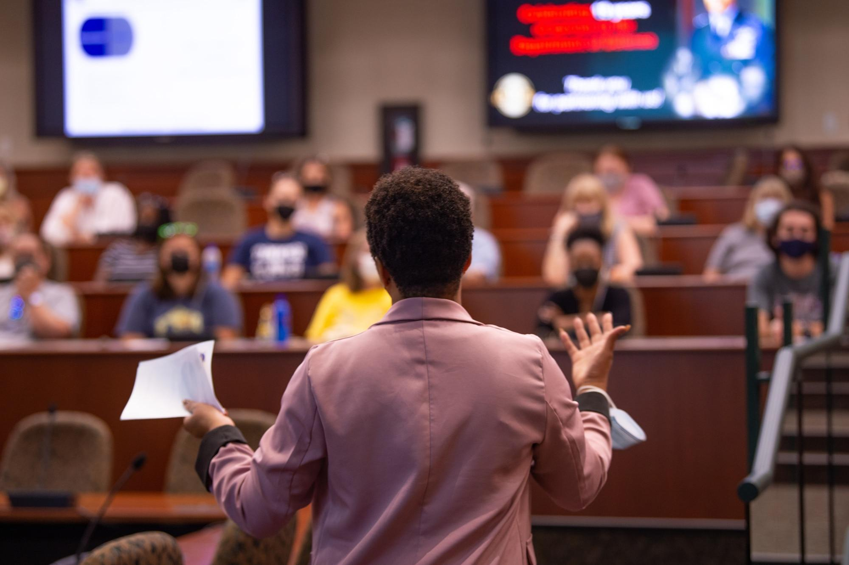
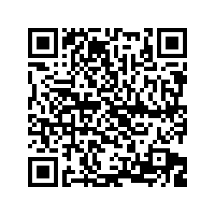
University Teaching 101
Michelle Schwartze, EdD

Slide 2
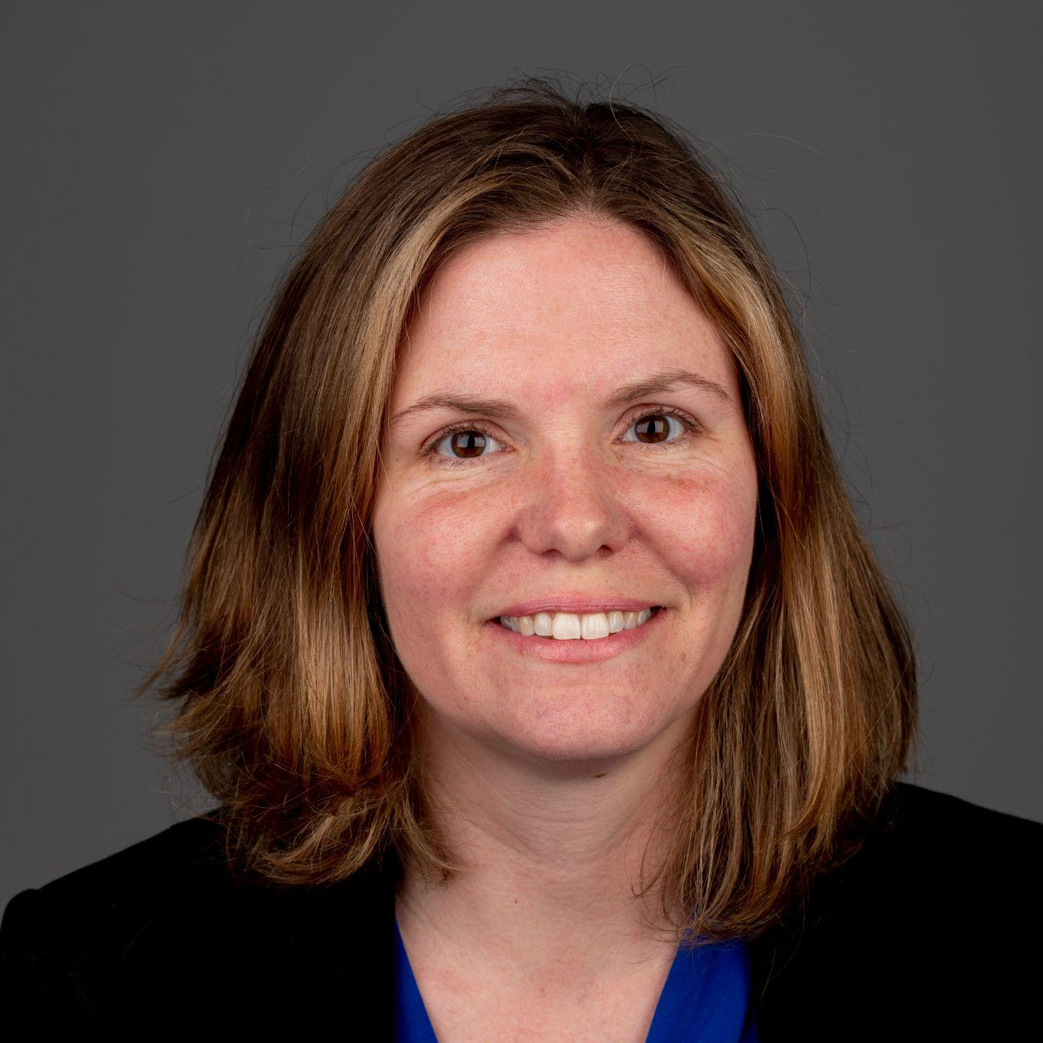
Michelle Schwartze
Associate Teaching Professor
Education
schwartzem@mst.edu

Slide 3
Today’s essential question
How do you effectively teach at the university level?

Slide 4
Why are you teaching?
Write it down and share with someone around you.
Notes:
Find your why to combat burnout

Slide 5
Why are your students in the class?
Is it required?
Is it an elective?
General education?
Notes:
Your students are not you.

Slide 6
If students wanted to learn the course content, they would already know it because they can find the information online.

Slide 7
Your students are not you.
Honor their differences and experiences.
What are some differences between your students and yourself?

Slide 8
What are your course learning outcomes?
Do students know what they are?
Are they written in a way students understand?
Do students know the real world consequences for failing to meet the standard?
Are they aligned with your assessments?

Slide 9
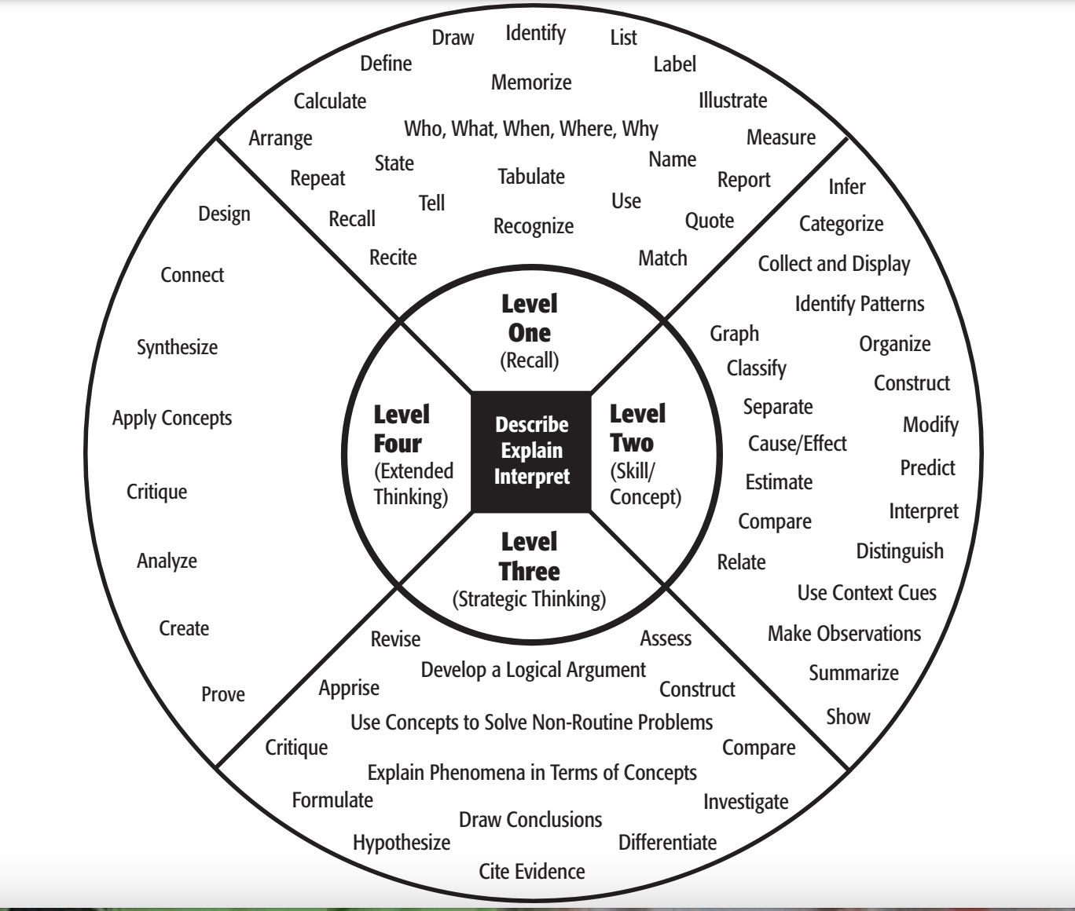
Have measurable outcomes!
Use Webb’s Depth of Knowledge to increase rigor.
List one outcome you could have for your course.

Slide 10
It is necessary to assess the outcome to make sure learning is happening!
How do you assess the outcome?
Notes:
Like running an experiment without collecting data

Slide 11
Assessment
Formative
Just in time
Feedback, not grade
Efficient, specific
Provide resources
Summative
Formal
Multiple outcomes assessed
High stakes
Notes:
On which are students more likely to cheat?
Formative (chef tastes the soup), summative (guests taste the soup)

Slide 12
Assessment Process
Identify learning outcomes in student-friendly language
Task analysis
Chunking content/skills
Examine data before teaching next session
1
3
5
2
4
6
Align summative assessment that mirrors real life tasks with clear criteria
Align formative assessment to each
Provide feedback and resources to students

Slide 13
Effective Teaching Checklist
Notes:
Look this over. What questions do you have

Slide 14
Teaching, often called an “art and a science”
Content knowledge
People knowledge
Effective teaching
Notes:
Emotional IQ

Slide 15
Let go of perfectionism
Limited resources
Continuous improvement, circumstances constantly change

Slide 16
https://create.kahoot.it/share/university-teaching-101/2146a661-5901-43e8-80ef-799e24a1cb58

Slide 17
What questions do you have?
schwartzem@mst.edu
Email me if you would like to observe.

Slide 18
Credits
Special thanks to all the people who made and released these awesome resources for free:
Presentation template by SlidesCarnival
Illustrations by Sergei Tikhonov
Photographs by Unsplash

Slide 19
Presentation design
This presentation uses the following typographies:
Titles: Raleway
Body copy: Barlow
Download for free at:
https://www.fontsquirrel.com/fonts/raleway
https://www.fontsquirrel.com/fonts/barlow
You don’t need to keep this slide in your presentation. It’s only here to serve you as a design guide if you need to create new slides or download the fonts to edit the presentation in PowerPoint®

Slide 20
Free templates for all your presentation needs
For PowerPoint and Google Slides
100% free for personal or commercial use
Ready to use, professional and customizable
Blow your audience away with attractive visuals

